Slide 1
DIAMOND PRICE PREDICTION
By
JIBIN JONAH

Slide 2
Problem statement
The problem is to predict the price of a diamond based on its features such as carat, cut, color, clarity, depth, table, x, y and z. The price of a diamond is the target variable that needs to be estimated by a machine learning model. The experience is a dataset of diamonds with their features and prices.
The problem needs to be solved because it can help customers and sellers to evaluate the value of a diamond and make informed decisions. It can also provide insights into how different features affect the price of a diamond.
To solve the problem, I would use various machine learning models such as linear regression, random forest, gradient boosting,Ada boosting and neural network.

Slide 3
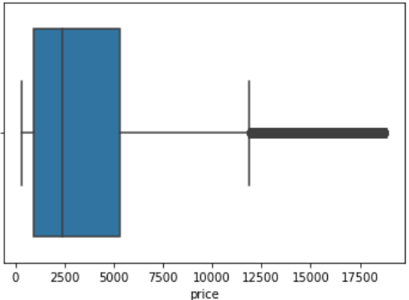
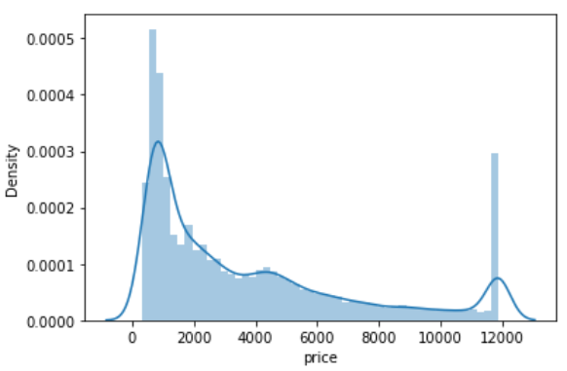
EDA
price (target)

Slide 4
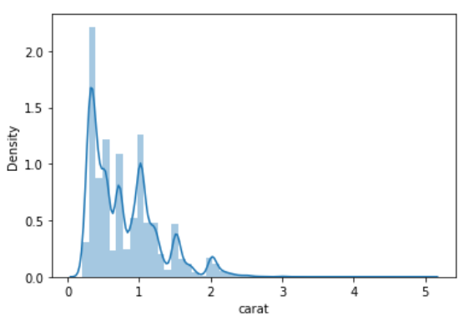
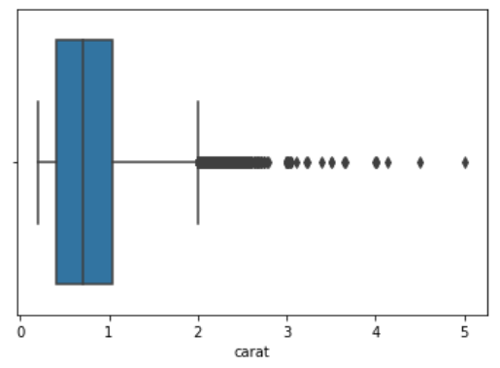
carat

Slide 5
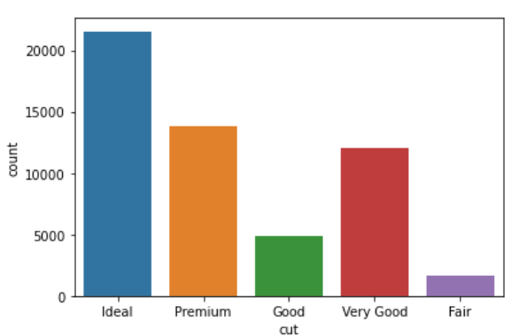
cut

Slide 6
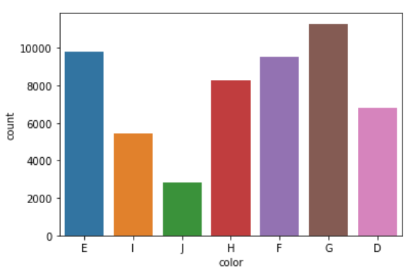
color

Slide 7
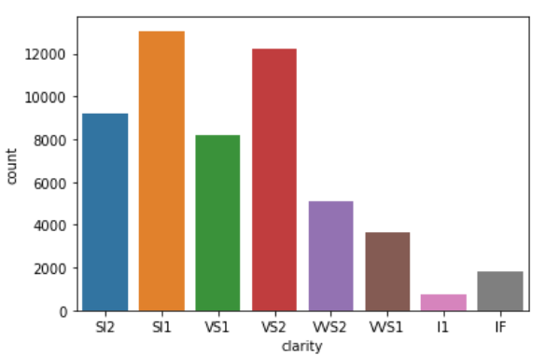
clarity

Slide 8
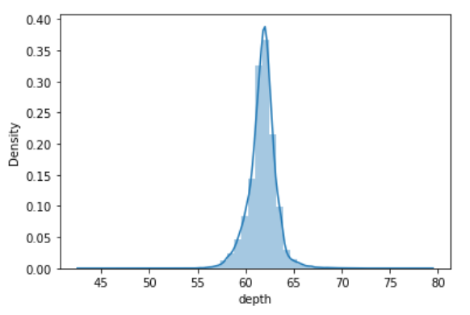
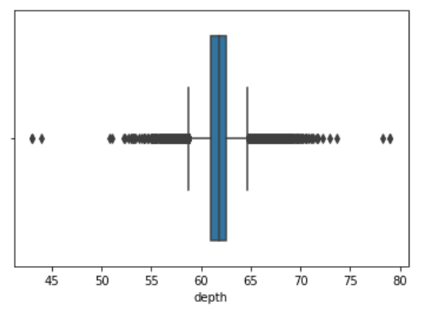
depth

Slide 9
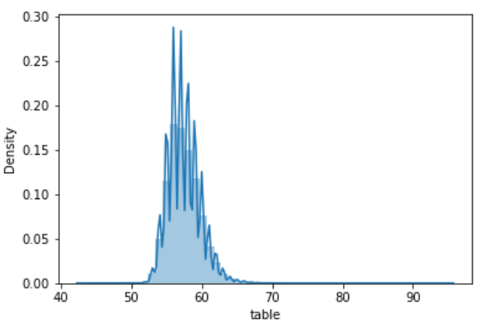
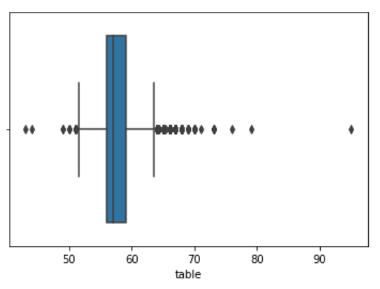
table

Slide 10
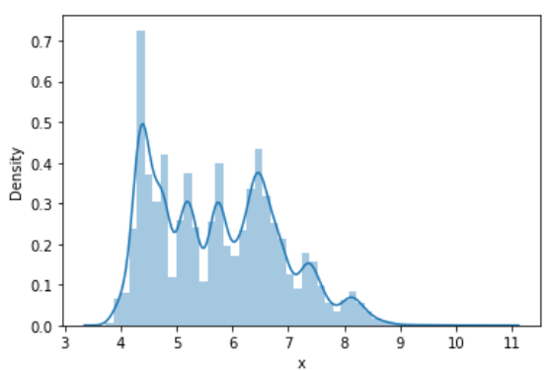
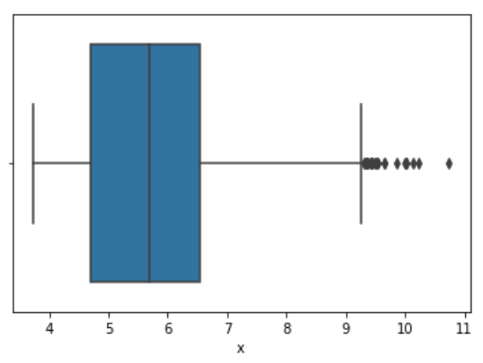
x

Slide 11
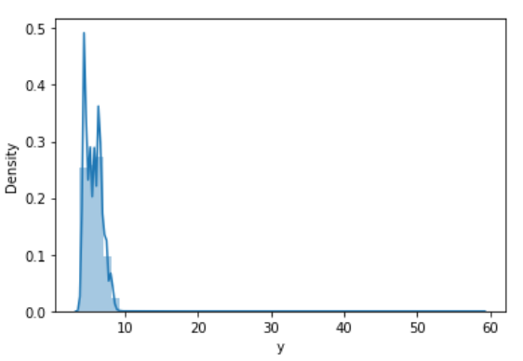
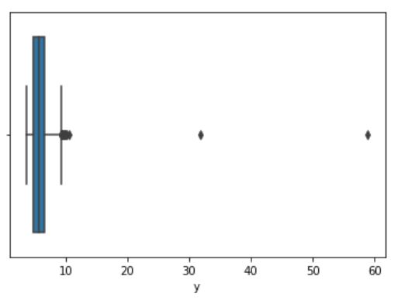
y

Slide 12
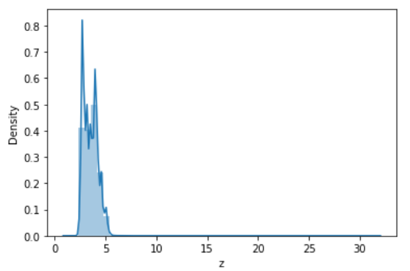
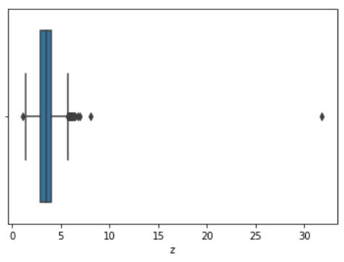
z

Slide 13






MACHINE LEARNING MODEL SCORE
linear regression
random forest regression
k nearest neighbors
Ada boost
grdient boost regressor
Neural Network

Slide 14
Key Findings
From the analysis we have done by creating various models we get to know which one is the best.
The accuracy we obtained on various models obtained by using different algorithms suggest that the Random Forest model is better.
It will be the right option to solve our business problem.

Slide 15
How it is useful for business
Accurate Pricing: Machine learning models can analyze large amounts of data and provide accurate pricing for a diamond, which can help businesses avoid underpricing or overpricing diamonds. Accurate pricing can lead to increased sales and profitability for businesses.
Customer Satisfaction: Customers can use this machine learning model to evaluate the value of a diamond, making informed decisions about purchasing diamonds. This can lead to increased customer satisfaction and loyalty for businesses that offer this feature.
Insight into Diamond Features: Machine learning models can provide insights into how different features of a diamond affect its price. This information can be useful for businesses when making decisions about buying or selling diamonds.

